Slide 1
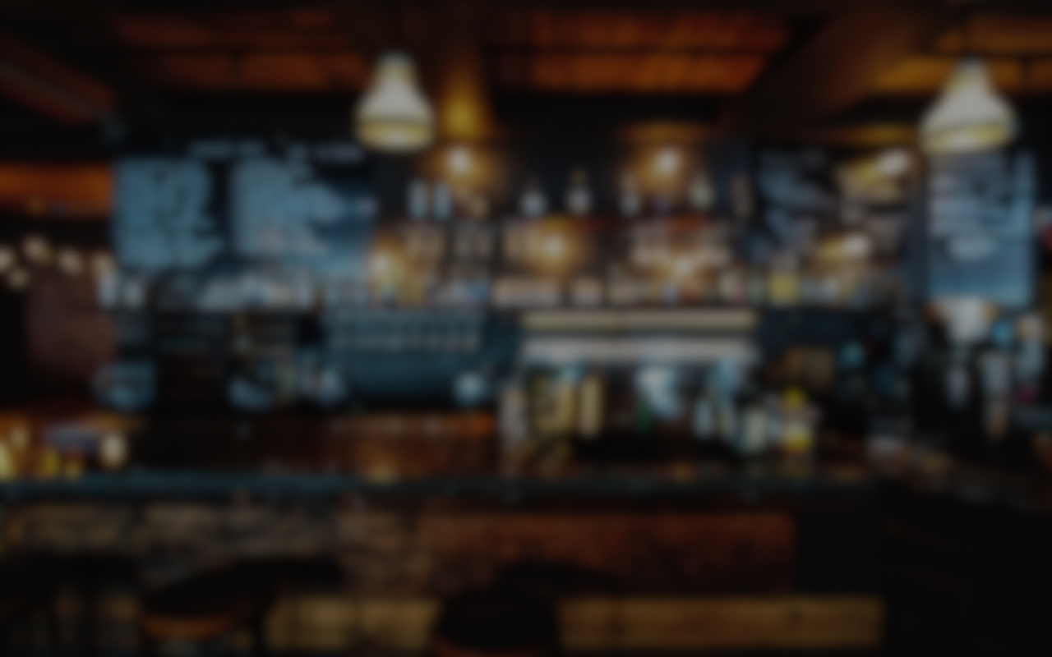
Plan Your Date Night
TM
Michael Arvelo
Delaney Charney
Jared Davis
Ronan Galvez

Slide 2

Terrible at making decisions?
Δ
In the mood for something new?
Δ
Eager to impress your date?
Then use
Plan Your Date Night
TM
for a stress free night of romance!

Slide 3




Concept
Plan Your Date Night is a web application that can help take the guesswork out of planning an impressive meal and cocktail pairing for your date. Following a series of short prompts, the user can generate a full meal and drink pairing and get the tools necessary for shopping and preparing their night.
+

Slide 4
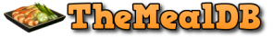

Process
Zurb Foundation CSS framework
The Meal DB api
The Cocktail DB api

Slide 5
Process
Breakdown of tasks and roles
Michael Arvelo | Cocktail Api Lead and Style Consultant
Delaney Charney | Integration Manager
Jared Davis | Meal Api Lead
Ronan Galvez | Front End Lead and Framework Management

Slide 6
Process
[Michael] | User Navigation and View Control Overflow-y = scroll vs hidden Scroll-snap-type = y mandatory Scroll-snap-align = start Troubleshooting nested scroll features
[Jared] | [Ronan]
Notes:
Everyone speak on own section

Slide 7

Demo

Slide 8
Directions for Future Development
Contact Section
Add movie selection API
Restaurant search
Dietary Restriction Filter
Seasonal Filter
Meal and Cocktail Tracker (No. times made)

Slide 9
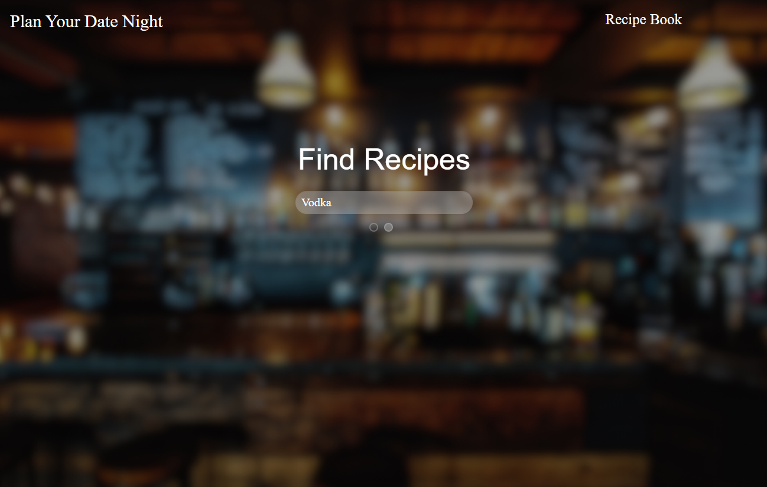
Links
Deployed: https://MichaelDevelopsCode.github.io/plan-your-date-night/
GitHub repo: https://github.com/MichaelDevelopsCode/plan-your-date-night

